Slide 1

Emergency Saturation Decompression
Dr Phil Bryson
Dr Jean-Yves Massimelli
Dr Luba Matity
Dr Ajit Kulkarni
Jean-Pierre Imbert

Slide 2
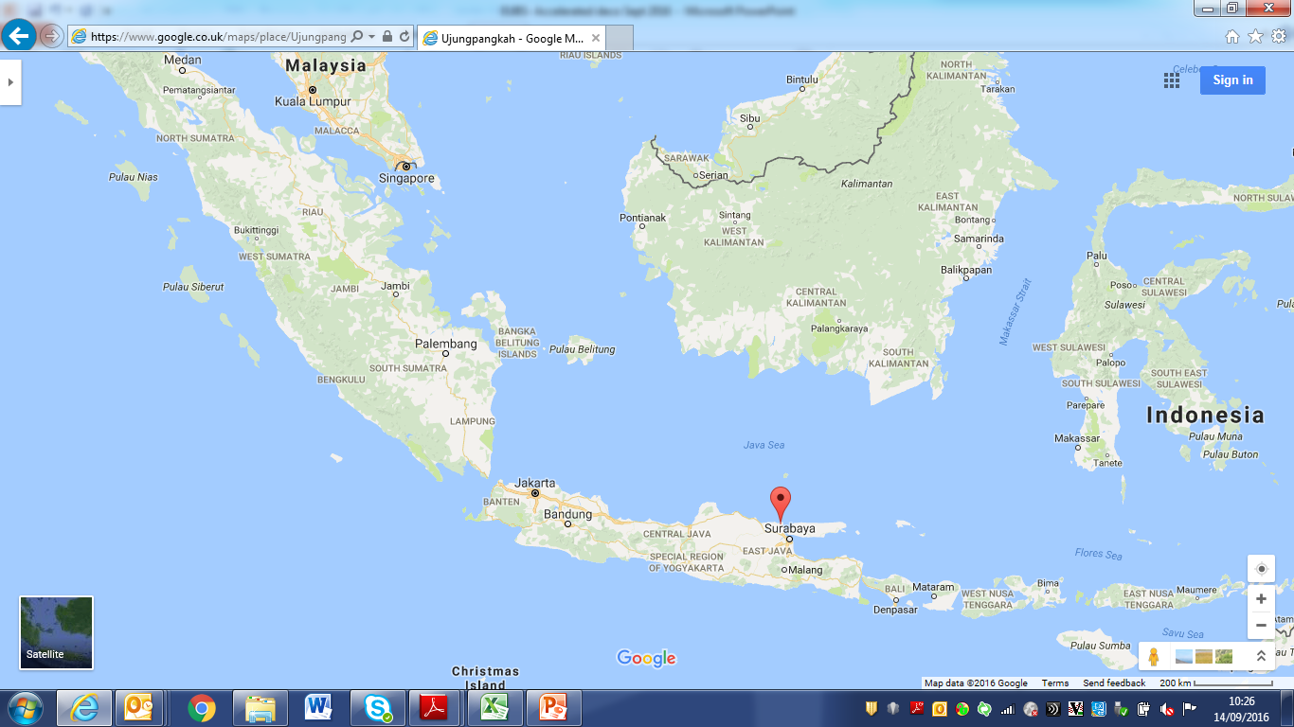
The Resolute case history (10th Jan 2013)

Slide 3
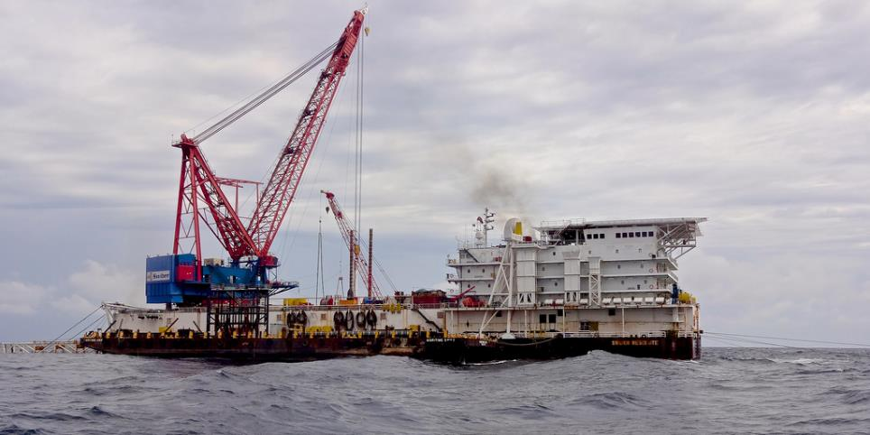
The Resolute barge

Slide 4
The Resolute problem
Three anchors had broken and the crew lost complete control of the Barge. As they lost anchors, weather started to push the barge beam-on. 45msw storage depth.
9 divers in Saturation – 6 in main chamber and 3 decompressing in the HRC at 28msw.
As she was caught beam-on, the barge rolled to about 15 degrees list. At that time assessment was made that the potential was there for the barge to capsize.
Within a few minutes, Team 1 who were in Deco in the HRC, was pushed back down to 45msw, then Team 2 & 3 transferred to the HRC.
All divers were then pushed down to 80msw (this was 20msw over 60msw bottom depth).
Around 0700, Project Manager, VP Operations and QHSE director are informed about the situation.

Slide 5
The Resolute (10TH Jan 2013)
Video removed as huge!

Slide 6
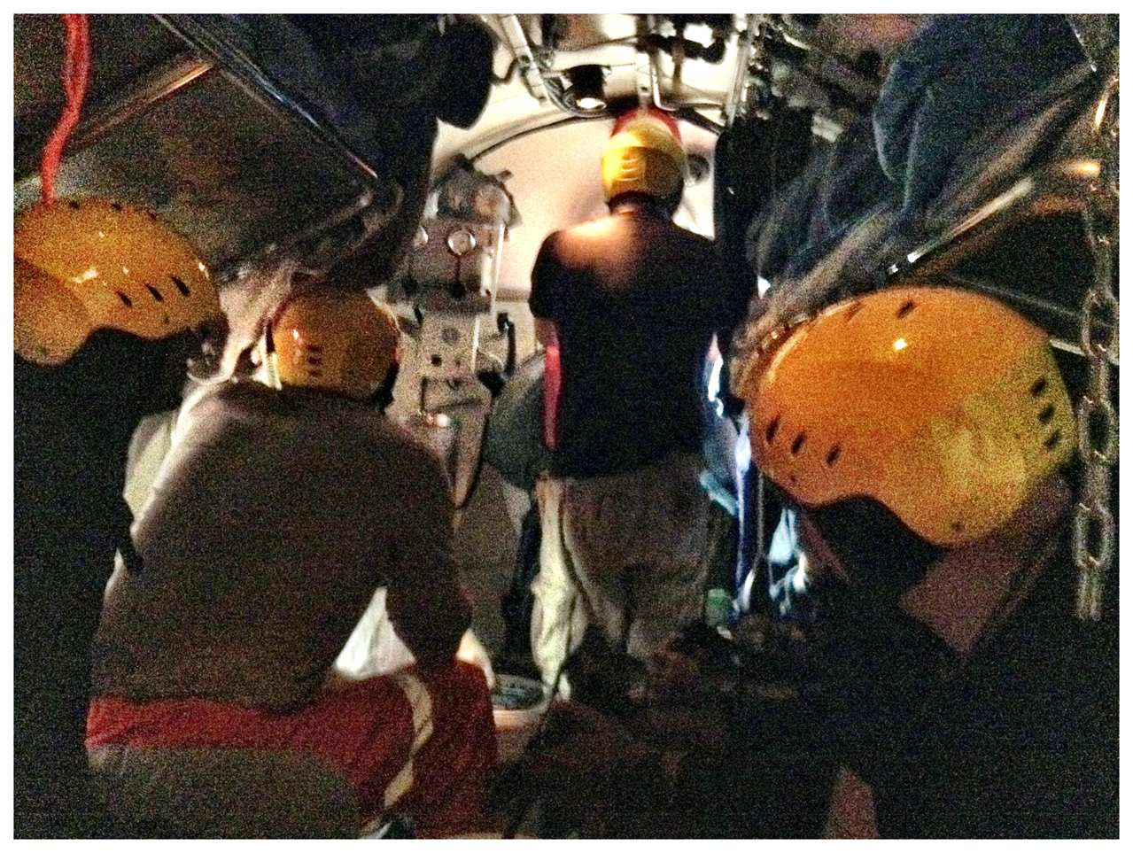

Slide 7
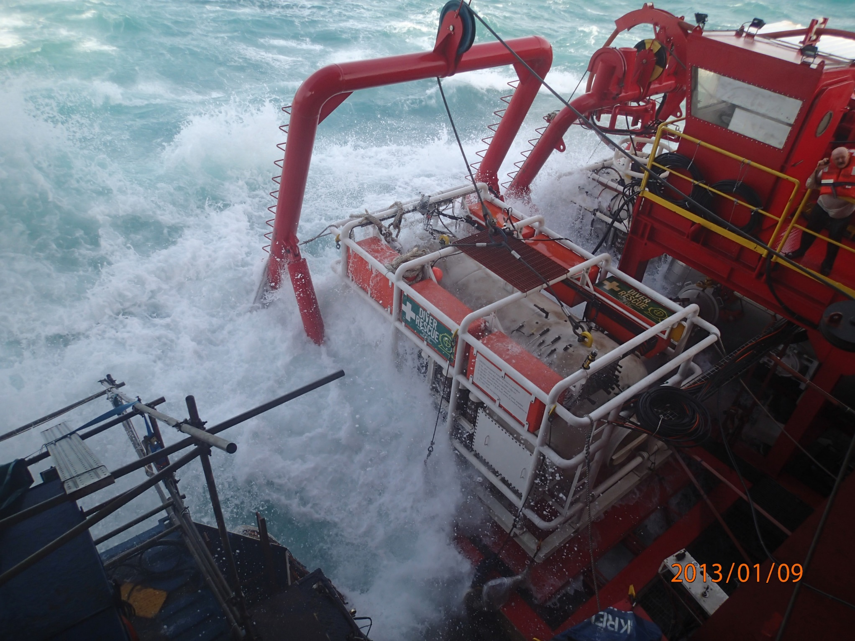
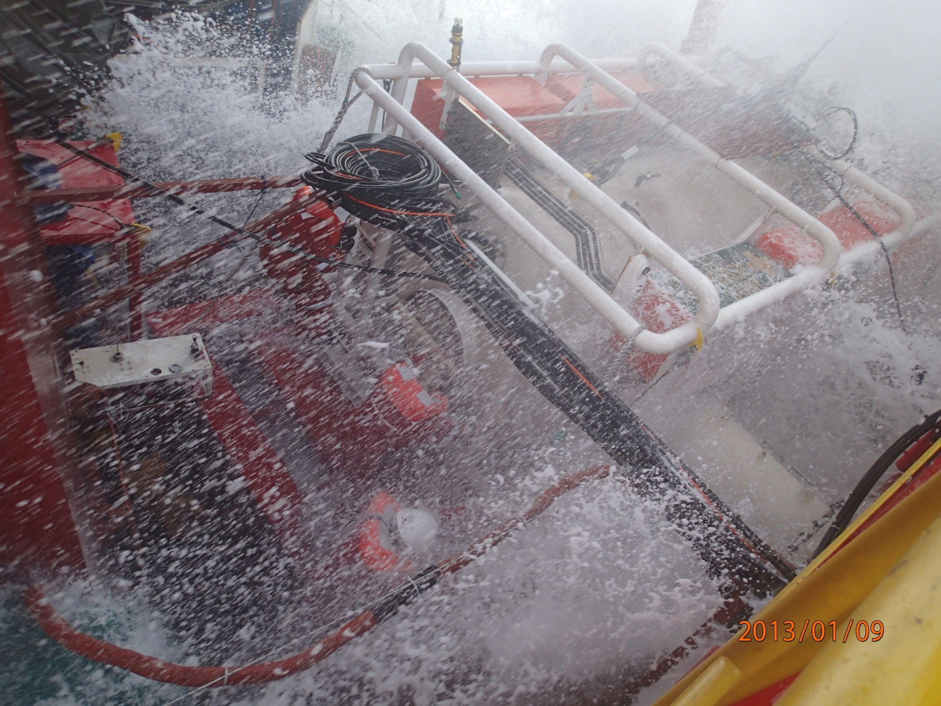
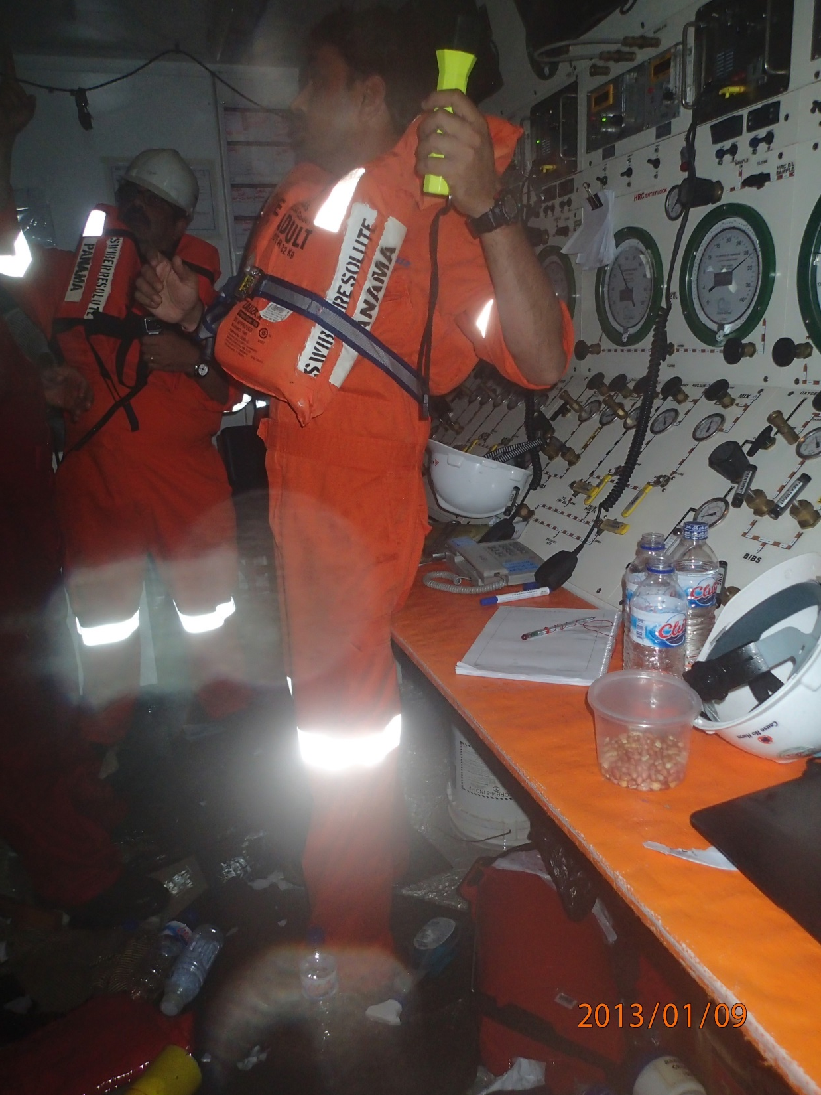
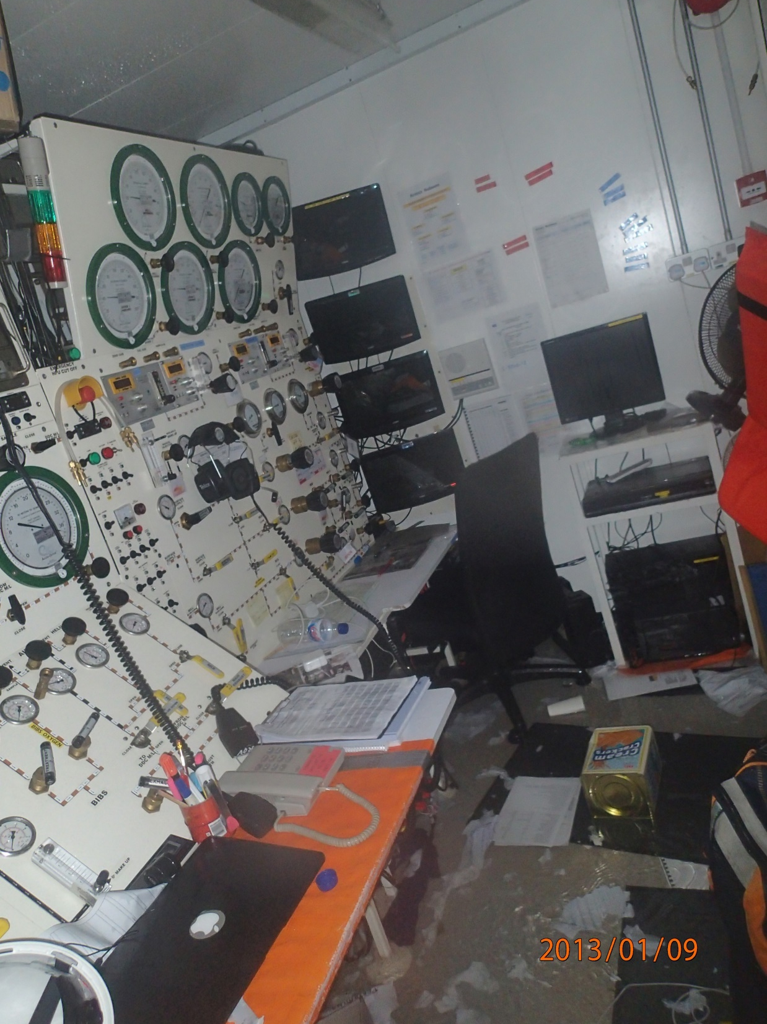

Slide 8
The “oh Shit” Moment
So…. Now what?
Multiple Messages around the globe to contacts in the industry
Search for Emergency Deco tables
Possible launch of the HRC
  No HRF
  Awful weather
  Terrible Sea conditions
Tug boats called to stabilise the barge
Advisory group pulled together
  Decisions based on……

Slide 9
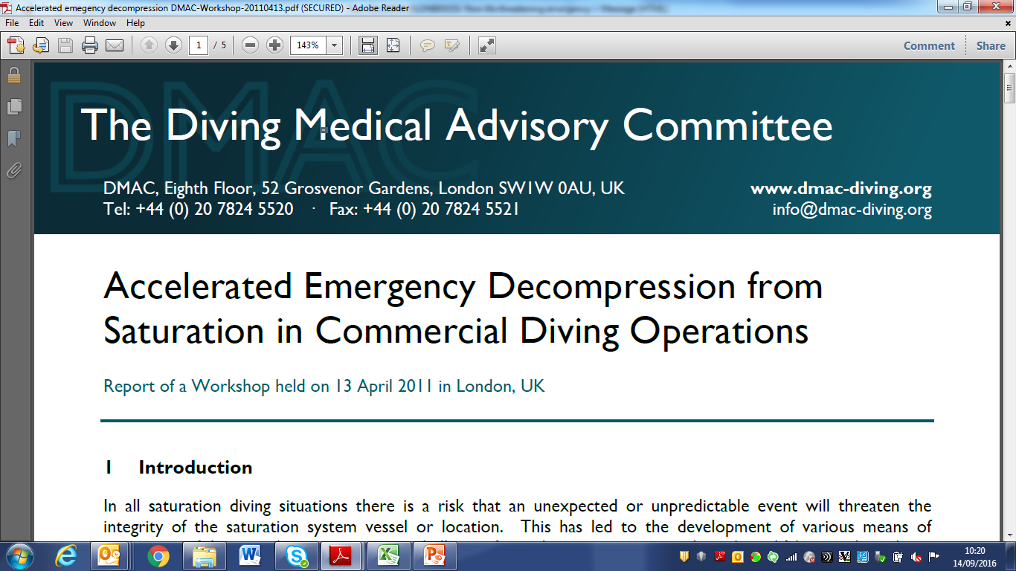

Slide 10
Resolute accelerated saturation decompression
The divers were given 1000mg Aspirin each
1 litre of water per hour for each diver for the first few hours.
Regular spells on BIBS Therapeutic gas
Exercise (as far as possible) one at a time during decompression.

Slide 11
Resolute accelerated saturation decompression
From 76msw to 55msw, the decompression rate was 7.6msw/hr. (Approx.)
From 55msw to 20msw, the decompression rate was 5msw/hr
Following a 3 hour and 35 minutes hold at 20 msw, the decompression was resumed and continued at a rate of 1msw/hr (60mins/msw) from 20 msw to 10 msw.
Following a 5 hour hold period at 10 msw, the decompression was resumed at a rate of 0.5msw/hr (120mins/msw) till the surface and successfully completed

Slide 12
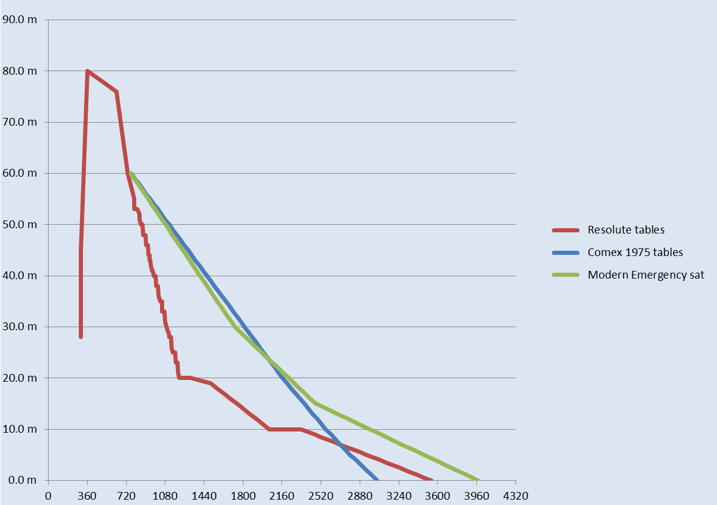
Comparison of the depth time diagram

Slide 13
Resolute emergency decompression
UPTDs – approx. 1300

Slide 14
Other issues here
Back up chamber/facilities?
Weather?
Other resources ?
1 ATA plane on standby in Singapore
Post event psychological support

Slide 15
Other issues here
It appeared that there was very little documentation of lessons learnt from previous events.
  Why?
  Where do advisors and indeed the team go to find guidance?
  Where do advisors go to find lesson from the past?
The DMAC report 2011 was clearly helpful but…

Slide 16
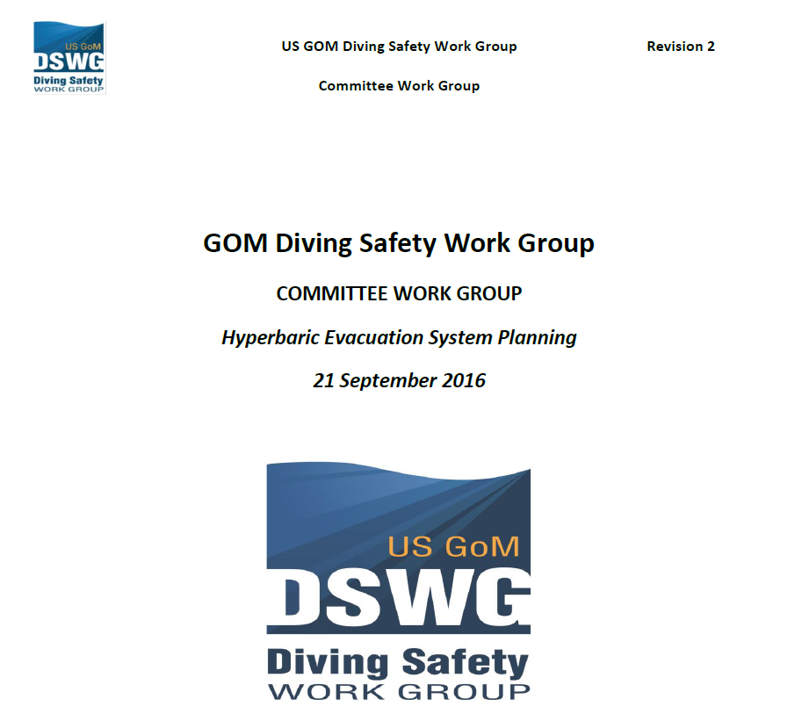


Slide 17
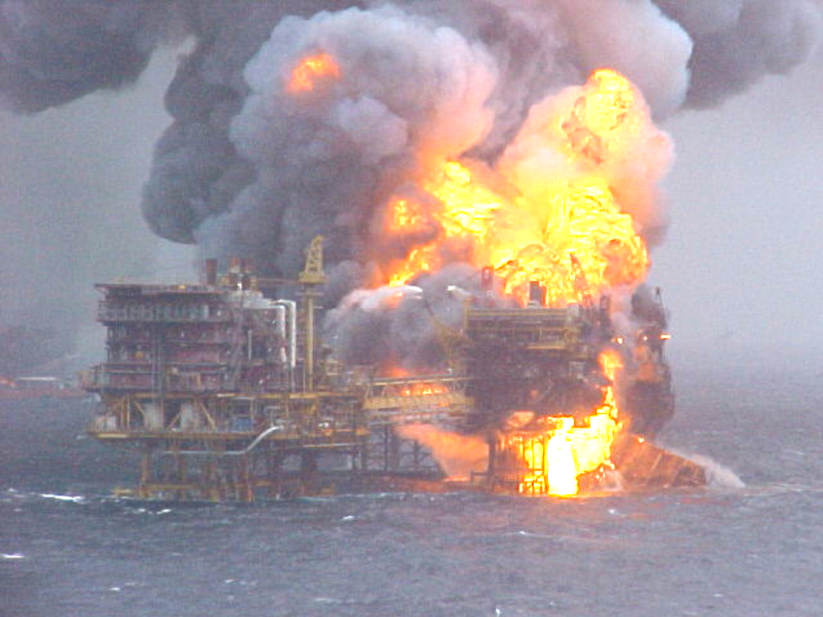
In retrospect there was another example
One afternoon in the Bombay High Field, India in 2005, during a medevac procedure in a rising tropical storm, a diving support vessel, the S. Suraksha, collided with the drilling rig, suddenly -
Both set on fire.
DSV drifted off and listing.
“Abandon ship”
BUT 6 divers still in saturation system at c.70msw.

Slide 18
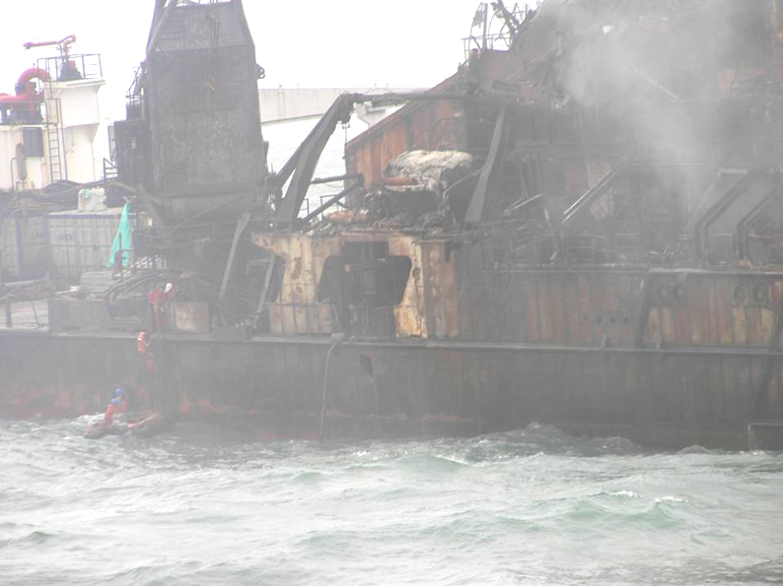
S. Suraksha, Bombay High Field, India
LIFEBOAT WAS NOT HABITABLE
(too hot)
and divers had to return to deck chamber at 70 m
Surface crew was driven away by flames.
DSV was abandoned.
Then - loss of all power

Slide 19
The concept of a peer reviewed paper
J-Y Massimelli and PB were determined to publish
  The story of the Resolute
  The evidence of other such situations
  A review of published emergency deco tables
  An analysis of the incidents that may then prove useful to others
  The concept of Lessons learnt and not lost
This took many years….
  Finally, we published peer reviewed paper for all to access
  2013 to Dec 2022 – almost 10 years..
  And of course …… we linked with others

Slide 20
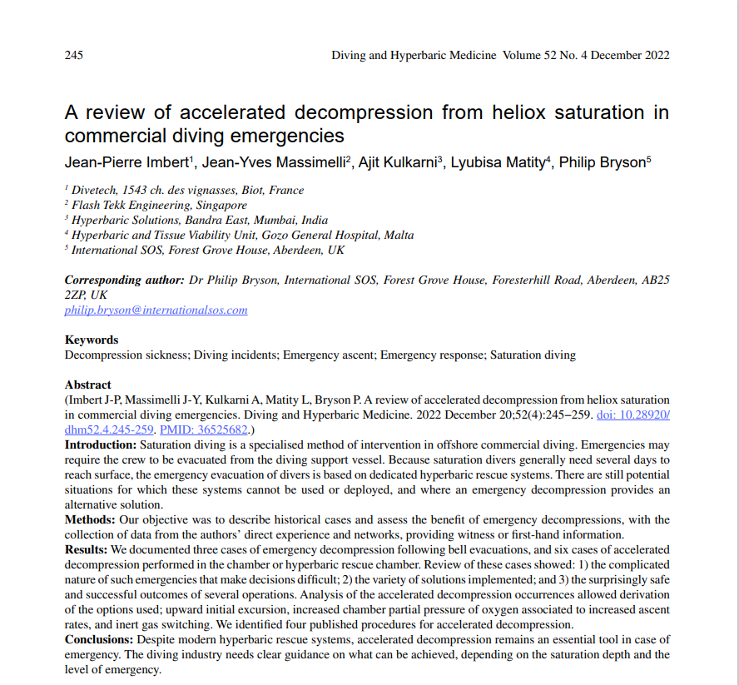

Slide 21
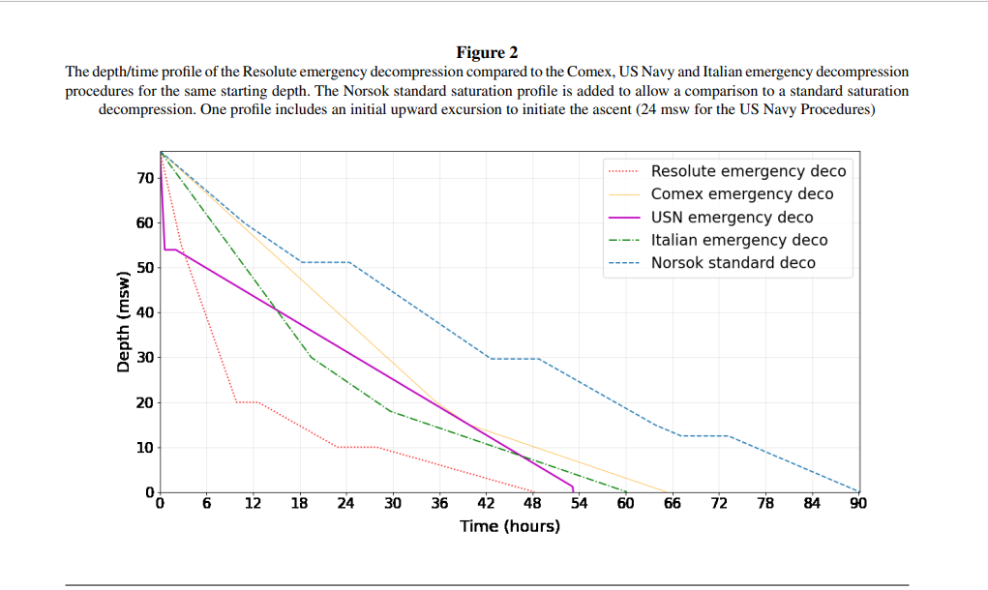

Slide 22
Are the Duke abort tables “lost”?

Slide 23
1982, Taipan one, Comex, Gabon.
In September 1982, the Comex barge ‘Taipan One’ was working in Cameroon alongside a single point mooring buoy. Diving operations were in progress at around 30 msw. Welders were working on the deck and a fire started from an oil leak. The crew managed to cut the anchor lines and a supply boat pulled the barge away from the buoy. In the process, the bell was dropped to the bottom and lost.
A rescue diver from a nearby DSV found the bell half submerged in the mud and after cleaning the porthole, saw the divers were alive.
The bell was recovered on to the deck of a supply boat that sailed to Douala.
A saturation chamber was mobilised in the harbour.
After 24 h, the bell was clamped to the chamber and the two divers finished their decompression using normal saturation procedures and without any symptoms of DCS.
This accident is the first that we are aware of to illustrate the chain of hyperbaric evacuation, onshore reception facility and decompression.

Slide 24
Emergency Decompression from shallow saturation?
In some circumstances, shallow saturation diving may offer advantages over surface supplied diving modes. A variety of factors may make saturation the preferred mode. It is generally recognised that the technique can be used as shallow as 13 metres but Contractor policy or local legislative conditions may impose a deeper limit.
The accepted method of evacuation for saturation divers is through the deployment of a hyperbaric rescue system (HRS). This may be a fully equipped self-propelled hyperbaric lifeboat (SPHL) or a hyperbaric rescue chamber (HRC). However, for shallow saturation operations, an option may be accelerated decompression of the chamber occupants.

